Slide 1

The Ethics and Economics of Environmental Protection
8. Radical perspectives I: Deep greens and eco-feminists

Slide 2
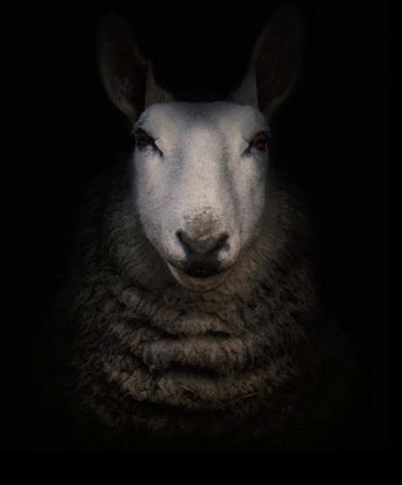

1. A change of tack
Deontology: freedom in philosophy
Deep green approaches
The risk of catastrophic harm
What do we owe one another?
Which path do deliberative democrats take?
Utilitarianism: well-being in the world
Pure hedonism (untenable)
1. SOCIAL SCIENCE PRINCIPLES
How is well-being generated?
2. SOCIAL SCIENCE MECHANISMS
How can we realise well-being in the world?
Policy direction
(Top-down prices)
Decentralised (market) discovery
(Bottom-up prices)

Slide 3
Emancipation through nature
L I F E
Freedom through:
Democracy
Harmony
Equality
Nature
We began with an ethical question: Are there limits to how much we can use the environment?
  Despite the scientific gloss, the limits debate concerns what we owe to one another
  I called this the question of reason: do we have obvious deontic responsibilities (n=1) or not (n=many)?
Today we move to the ontological question: what are the limits we’re transgressing?
  Does our basic error lie in our anthropocentrism, and the (alienating) dualism it introduces?
  If so, the solution is to achieve ethical unity not through reason, but through nature
Political philosophy
Political economy
Freedom from:
Oppression
Harm
Want
Economy
W E A L T H

Slide 4
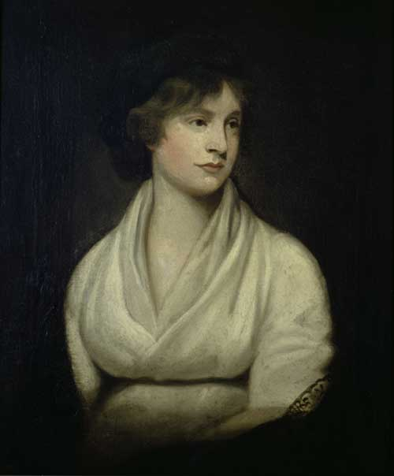
Mary Wollstonecraft’s [M.R.’s] example
M.R. aimed to overcome the dualism between men (seen as rational, logical) and women (emotional, instinctive): in fact, women are rational creatures too
Patriarchy was just a part of the broader “human-nature” dualism which constructs nature as external to reason
  Women could not extract themselves from nature, unlike awesome men
  Women were therefore subordinated, like “brutes” (i.e., animals), to the needs of reason
  More generally, M.R. hints that women’s subordination, like that of nature, the poor, and minorities, was presented as natural and necessary
Freedom, for M. R., meant collapsing artificial, essentialised differences which oppose women to men, and which exclude women from education and agency
  Ecology and eco-feminism rest on the same basic ontological strategy: to show that humanity and nature form a unity through which the human good must be understood

Slide 5
Debates within radical environmentalism
 | Deep green | Light green
Conception of ecological value | Self-contained; separate from human values | Derivative; dependent on human values
Conception of flourishing | Biocentric: Human well-being depends on ecosystem flourishing | Anthropocentric: Ecosystem stability depends on social and human flourishing
Attitude to human well-being | Social and ecological change must dethrone human well-being | Social and ecological change must be governed for human well-being
Ethical expression | Intrinsic value | Value pluralism
View of reason | N = 1 | N tends towards 1
Examples | Aldo Leopold’s “land ethic”; The Gaia thesis; Deep Ecology; Left Biocentrism | The New Left; Social Ecology; Green Localism; The Transition Movement

Slide 6
2. The philosophy of ecology
The well-being and flourishing of human and nonhuman Life on Earth have value in themselves (synonyms: intrinsic value, inherent value). These values are independent of the usefulness of the nonhuman world for human purposes.
Richness and diversity of life forms contribute to the realization of these values and are also values in themselves.
Humans have no right to reduce this richness and diversity except to satisfy vital needs.
The flourishing of human life and cultures is compatible with a substantial decrease of the human population, The flourishing of nonhuman life requires such a decrease.
Present human interference with the nonhuman world is excessive, and the situation is rapidly worsening.
Policies must therefore be changed. These policies affect basic economic, technological, and ideological structures. The resulting state of affairs will be deeply different from the present.
The ideological change is mainly that of appreciating life quality (dwelling in situations of inherent value) rather than adhering to an increasingly higher standard of living. There will be a profound awareness of the difference between big and great.
Those who subscribe to the foregoing points have an obligation directly or indirectly to try to implement the necessary changes.
Bill Devall and George Sessions, Deep Ecology: Living as if Nature Mattered, 70
All forms of ecology are deeply uncomfortable with anthropocentrism
  Anthropocentrism is a peculiarly modern pathology, evincing from our obsessions with the “individual” and technology
  Though we are inescapably part of nature, post-Enlightenment thought (i.e., reason) elevates us above nature, so that we view it as a set of materials for consumption
  Even democratic approaches misunderstand the demands of nature: nature cannot be understood through the lens of human concerns, but must be understood as having its own teleology
Societies, and their inhabitants, must be reconceptualised as biocentric entities (i.e., the economy-nature continuum must be collapsed)
  Wildernesses are an integral part of nature, which must be preserved;
  The greatest threat to nature is the growth of the human population, which should be reduced;
  Destructive resource consumption can only be curbed by a radical return to simple living.

Slide 7

Lighter green alternatives
An obvious problem of a theory of ecology that lacks a proper theory of the individual is that it essentialises that individual via a singular theory of environmental value
  How do we deal with problems of disagreement or (apparent) conflicts of interest?
Moreover, it assumes that environmental problems can only be dealt with metaphysically, which makes an enemy out of everyone—including most environmentalists
  And maybe even deep ecologists who, after all, are steeped in the very anthropocentric metaphysic that must be expunged!
Lighter greens hold that we should instead pursue “equality through ecological virtue”
  Spontaneity, decentralisation, and cooperation through meaningful local politics
  Since the problem is not people as such, but their disconnect from natural values, the key to sustainability lies in truly free and fair social activities that confront social, economic, and ecological problems as interconnected failures of capitalism

Slide 8

Eco-feminism I
Eco-feminism targets the ontological dualism between humans and nature
  As in Wollstonecraft’s view, “humanity” is reduced to “men” ; women are implicitly treated as irrational and parochial (like nature), such that their subordination is invisible
  Dualism is not only philosophically incoherent; it also perpetuates inequalities of material and political power
Philosophical unity would allow us to see that we need to decommodify nature
  We need to reconnect with (recognise our embeddedness within) nature
Women have a central role in this re-imagining, due to their understanding of (its) oppression and (more contentiously) their identities as care-givers
  Advocates here cite the various women’s resistance movements against the destruction or misuse of nature: Chipko (India); the Green Belt Movement (Kenya); the Love Canal campaign (U.S.); the Greenham common protests (U.K.); the Women’s Environmental Network (Int’l), etc.

Slide 9
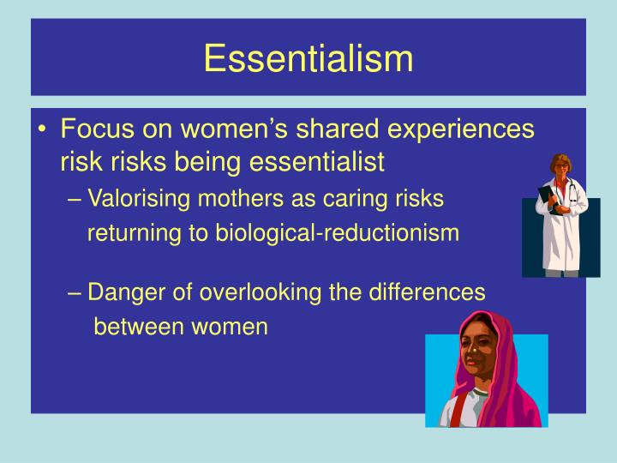
Eco-feminism II (can we escape essentialism?)
Eco-feminism has always involved an important tension between theory and practice
  Practitioners and academics tend to be different: practitioners (largely in the global south) aim for solidarity and effect; academics (largely in North America) aim for philosophical rigour
More problematically, even if there was no distinction between theory and practice, is it possible to avoid essentialism?
  What is a “woman”? How does she relate to the environment? (Or, who gets to say?)
  But even if we avoid an essentialist view, doesn’t the avoidance of essentialism entail an “essence”?
  The fundamental issue here is (again) disagreement: what are the aims of ecology: theoretical perfection? Or global change?

Slide 10
3. Putting the debates together
Unity with nature
(or, the need to escape essentialism)
1. The unity of humanity and nature in ecology
2. Neoliberal alienation (?)
N = 1
N = too many
The question of reason (how many reasons will count?)
N = 1
N = ∞
A preoccupation with ends
A preoccupation with means
Dreams of neoclassical control
The spectre of neoliberalism
Duality with nature
(or, the need to make a decision)

Slide 11

Summary
Given the problems facing environmental economics in all its forms, it makes sense for us to revisit radical environmentalism, which was intended to avoid the aporia of capitalist economics
The problem we ran into over the past two weeks is that economics appears incapable of organising heterogeneous people in a predictable (problem-solving) way
Can we escape the problem by turning to ontology—(almost literally) reordering the way people think and engage with the environment?
In this lecture we examined “early” forms of radical environmentalism: deep green ecology, and its off-shoots light green ecology and eco-feminism
These are emancipatory politics: if people can be removed from the alienating dualisms that liberal capitalism imposes on us, they may be able to achieve unity with the environment
Unity, however, may come at a terrible price, and may not be necessary. Is the problem that people are alienated from one another? If so, social unity may be sufficient to halt environmental harm
The problem appears to be, however, that all forms of emancipatory ecology end up essentialising at least some (if not most) of the people they are trying to free
If people differ in their reasons and beliefs, rather than according to specific identity markers, then unity may only be achieved though (alienating?) coercion—unless the person wielding the stick happens to know the “truth” for all
This is not necessarily a problem in itself, for we may simply want to get things done. But the question we then need answering is, if we cannot get agreement (and even if we could), how do we know that our decisions will be good for the environment?

